Slide 1

Department of Computer Science Engineering & Engineering
Mini Project Presentation (KCS-354)
On
“ Date mate – A dating Website “
Raj Kumar Goel Institute of Technology Ghaziabad
5th KM. STONE, DELHI-MEERUT ROAD, GHAZIABAD (U.P)-201003
Students
Vivek Kumar Gupta(Lateral Entry)
Shiv Sagar Vishwakarma (Lateral Entry)
Devmani Tripathi(2100330100081)
Under the Guidance of
Rahul Sharma Sir
Department of CSE

Slide 2
CONTENTS
INTRODUCTION
OBJECTIVE
LITERATURE SURVEY
METHODOLOGY
HARDWARE AND SOFTWARE USE
WORK PROGRESS
SCREENSHOTS
REFERENCES

Slide 3
INTRODUCTION
Date mate is a dating website which help to anyone date online across the world.
Dating Websites are a specific kind of social media that are designed for people to find partners and friends.
Date mate doesn’t depend on gender it will work for Hetro as well as for Homo Sexual.
It will allow users to communicate and interact with many different people that have the same interests.
the dating website project aims to create a platform that helps people find meaningful connections and build long-lasting relationships based on shared interests and values.

Slide 4
OBJECTIVE
You can meet new people on the application as this is world wide.
It will increase the probability of finding your match.
It has great features to enhance your experience.
It will make sure about your safety.
Less effort in approaching.
You can intrect with multiple people at once.
You can filter the dating pool.
It’s good for shy people.
It will help to find lifelong partnership.

Slide 5
Literature Survey
Reference no. | Author’s Name , Year | Survey(Research) | Outcomes
Paper 1 | Karoline Gatter & Kathleen Hodkinson (2015) | Research on the differences between Tinder versus online dating agencies: Questioning a myth & an exploratory study | Growing a social network, gaining new friends and having a sense of safety and control.
Paper 2 | Jenelle ward (2016) | Impression management on a matchmaking mobile app for dating sites | Allows to advertisers to gain favor with the public by promoting certain aspects of ther business.
Paper 3 | Natasha saltes (2018) | Disability, self-identity and disclosure in the online dating environment | Avoid the putting lots of personal details on your profile.

Slide 6
METHODOLOGY
Front-end
HTML, CSS, BOOTSTRAP
Back-end
Javascript, PHP
Database
MYSQL

Slide 7
HARDWARE & SOFTWARE USE
Hardware
OS - Windows/Mac/Linux
Processor – i3 Intel core
RAM - 4 GB
Software
Code editor - VS code/Notepad++
Web server - XAMPP/WAMPP
Web browser - Edge/Chrome

Slide 8
Work Progress
  Introduction: Dating Websites are a specific kind of social media that are designed for people to find partners and friends.
  Current activities: Date mate is done. Now user can registration and can log In on that. Whether we are implementing some other task like chat, video conferencing and location tracking for this we use k-mean clustring.
  Search and Matching Algorithm: Dating website works on this and we are still imporving it.
  Future Plans: It will take around a bi-month and after implementing k-mean clustring, we can access user location as well their interest. After that we need to buy domain and hosting and it can be the next popular dating site.
  Budget and Resource: We will buy domain .com from hostinger for this we have to pay $100 each year.
  Whether we can manage when it will popular.
  Conclusion: At all this can be a next level site. But we need to keep remember that for k-mean clustering it takes time to implement. We have to complete other dating apps like tinder, grindr while coming to the market and we will do.

Slide 9
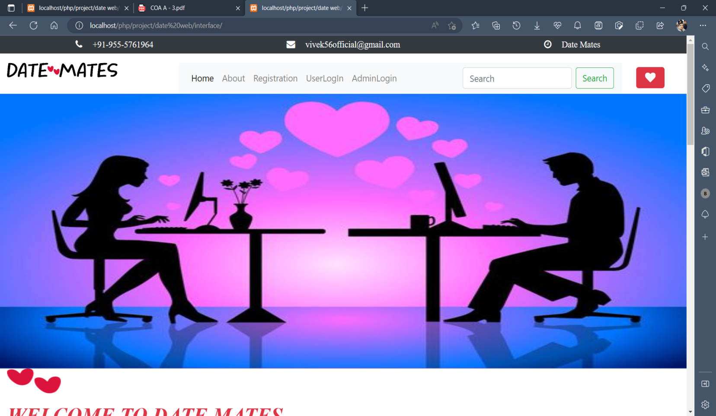
Sample Screenshot
Home page

Slide 10
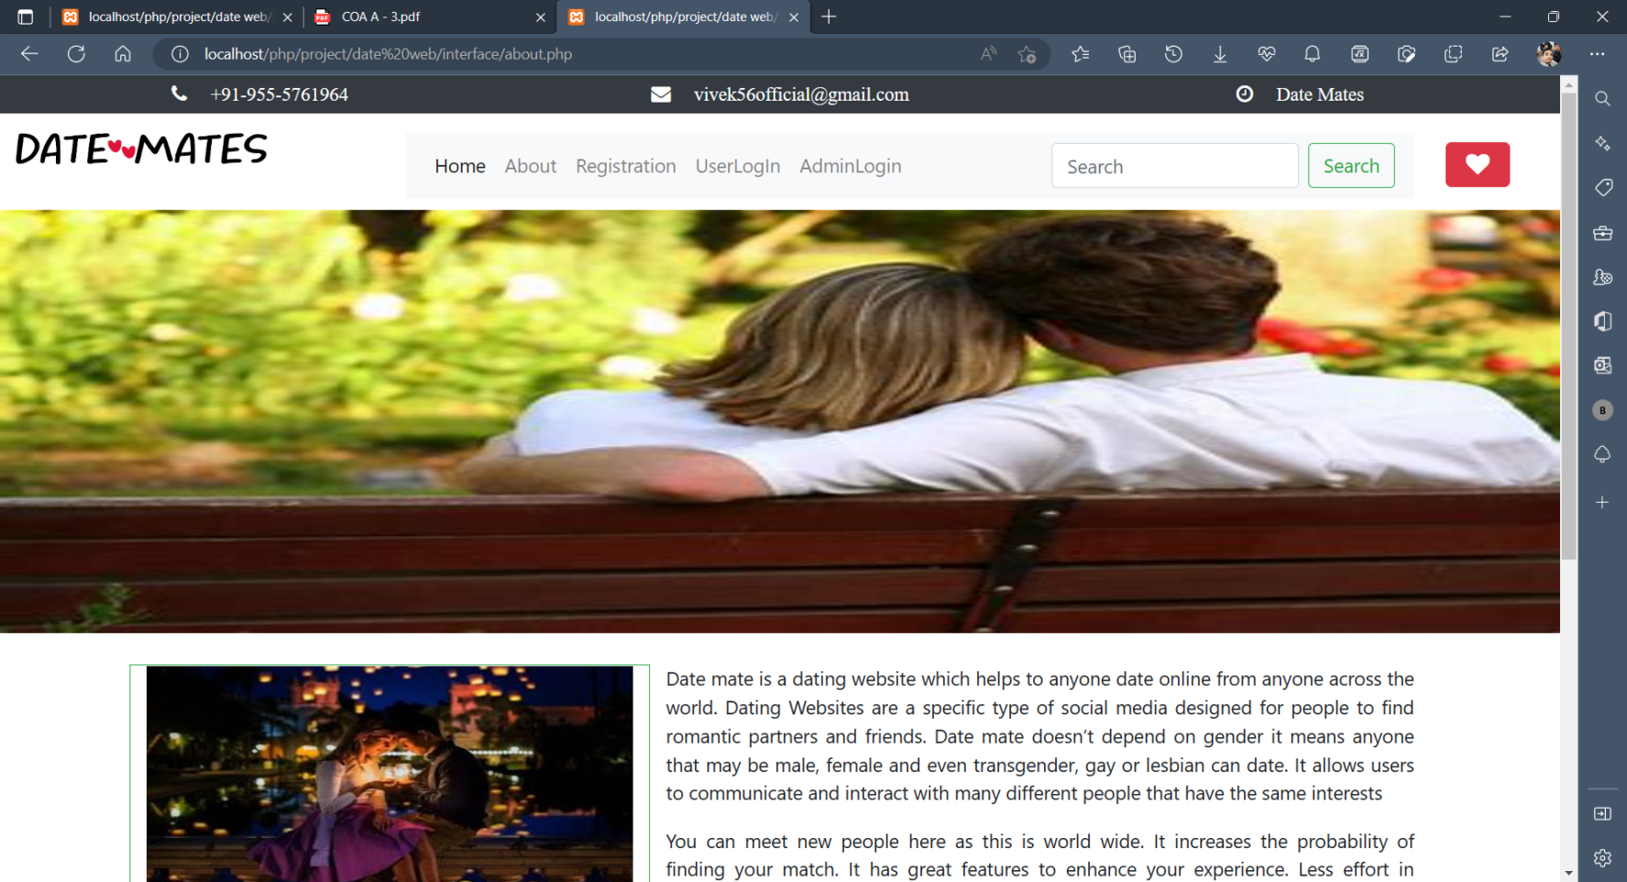
Sample Screenshot
About

Slide 11
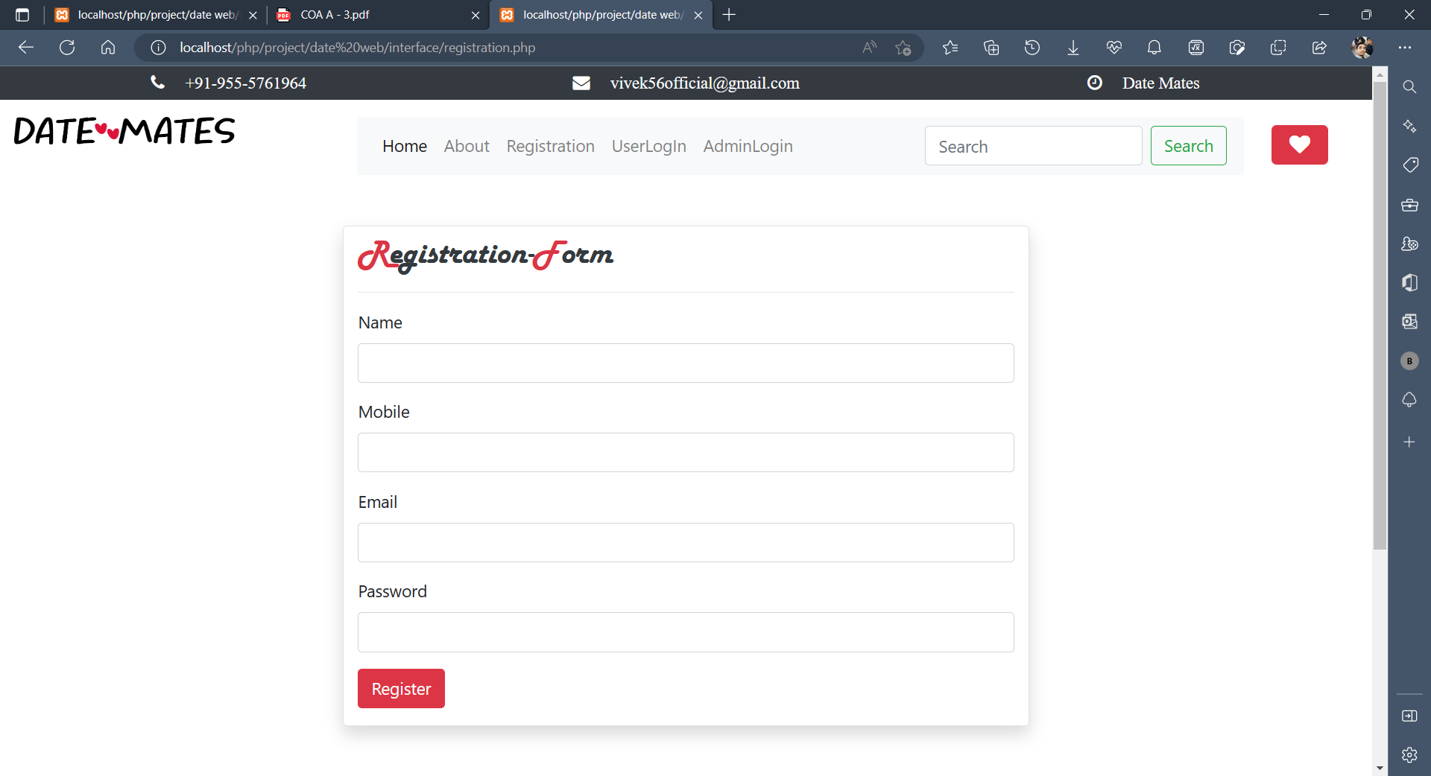
Sample Screenshot
Registration

Slide 12
References
[1] "The Business of Love: An Overview of the Online Dating Industry" by Brian Anthony and Melanie D. Trot man (2017) - This article provides a comprehensive overview of the online dating industry, including trends, statistics, and key players.
[2] "Online Dating: A Critical Analysis From the Perspective of Psychological Science" by Eli J. Finke et al. (2012) - This research article offers a critical analysis of online dating from a psychological perspective, including its strengths and weaknesses.
[3] "Swipe Left: Dating Apps Have Killed Romance" by Lucy Jones (2018) - This opinion piece offers a critical perspective on the impact of dating apps on modern romance and relationships.
[4] "Love in the Time of Algorithms: What Technology Does to Meeting and Mating" by Dan Slater (2013) - This book provides a broader overview of the role of technology in modern dating and relationships, including insights into the history and future of online dating.
[5] "The Do's and Don'ts of Online Dating" by Consumer Reports (2021) - This article provides tips and advice for safe and effective online dating, including guidance on creating a profile, communicating with matches, and staying safe.

